Slide 1

Object Recognition System​ Image, Video, and Webcam Detection
Presented By:
Vrushali Chaube
Swathi Illuru
Akhil Jayanti
Harsha Kota
Under the Guidance Of
Mr. Anil Kumar Shaw
Mentor – Infosys Internship Program
27/12/2024

Slide 2


Contents
Introduction ​
Objectives​
Proposed System ​
Architecture and Use Case Model ​
Methodology​
Model Comparison ​
Results ​
Challenges & Future Enhancements ​
Conclusion & Q&A

Slide 3
INTRODUCTION
Overview:​
Object detection is a critical task in computer vision, enabling systems to identify and localize objects within images or video feeds.​
This project implements and compares multiple state-of-the-art object detection models for diverse scenarios, including: ​
Faster R-CNN: High accuracy for detecting complex and overlapping objects.​
Mask R-CNN: Adds segmentation capabilities for pixel-level object classification.​
YOLOv5: Focuses on real-time detection with speed and efficiency.​
Purpose:​
To explore the strengths of different models in varying environments.​
Provide real-time and accurate detection solutions across multiple inputs.​
Key Features:​
Supports detection for images, videos, and live webcam feeds.​
Delivers visual outputs with bounding boxes and detailed detection statistics.​
Relevance:​
Real-time object detection has applications in surveillance, automation, and AI-powered solutions.​

Slide 4

OBJECTIVES​
1. Develop a Comprehensive Detection System:​ - Integrate multiple models (Faster R-CNN, Mask R-CNN, YOLOv5)
for diverse use cases.​ - Support input formats including images, videos, and live webcam
feeds.​
2. Ensure High Accuracy and Real-Time Performance:​ - Balance accuracy and speed across different detection models.​ - Provide pixel-level segmentation and precise object localization
where required.​
3. Enhance User Accessibility:​ - Build an interactive and user-friendly interface for seamless
detection tasks.​ - Allow dynamic configuration of parameters like confidence
thresholds.​
4. Optimize for Versatility:​ - Compare and analyze model performance under varying conditions.​ - Deliver detailed detection outputs tailored to specific scenarios.​

Slide 5

PROPOSED SYSTEM​
Key Features:​
Supports multiple detection modes:​
Image Detection: Process uploaded images for object identification.​
Video Detection: Analyze video files frame by frame.
Webcam Detection: Real-time detection via live camera feed.​
Core Components:​
Frontend: Interactive and user-friendly interface using Streamlit.​
Backend: Integrated multiple object detection models, including Faster R-CNN, Mask R-CNN, and YOLOv5, for flexibility and performance.​
Processing Framework: Utilizes PyTorch and OpenCV for efficient data handling.​
Advantages:​
Easy-to-use interface suitable for technical and non-technical users.​
Dynamic configuration (e.g., confidence threshold adjustment).​
Provides clear and visually annotated detection outputs.​

Slide 6
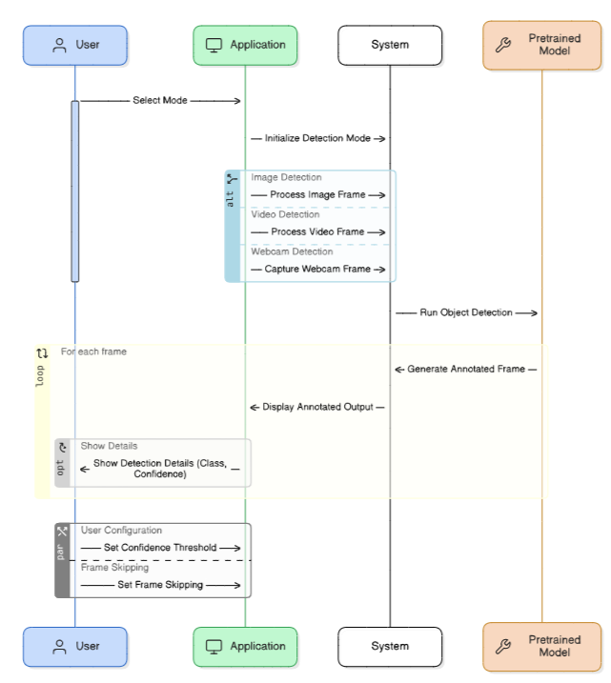
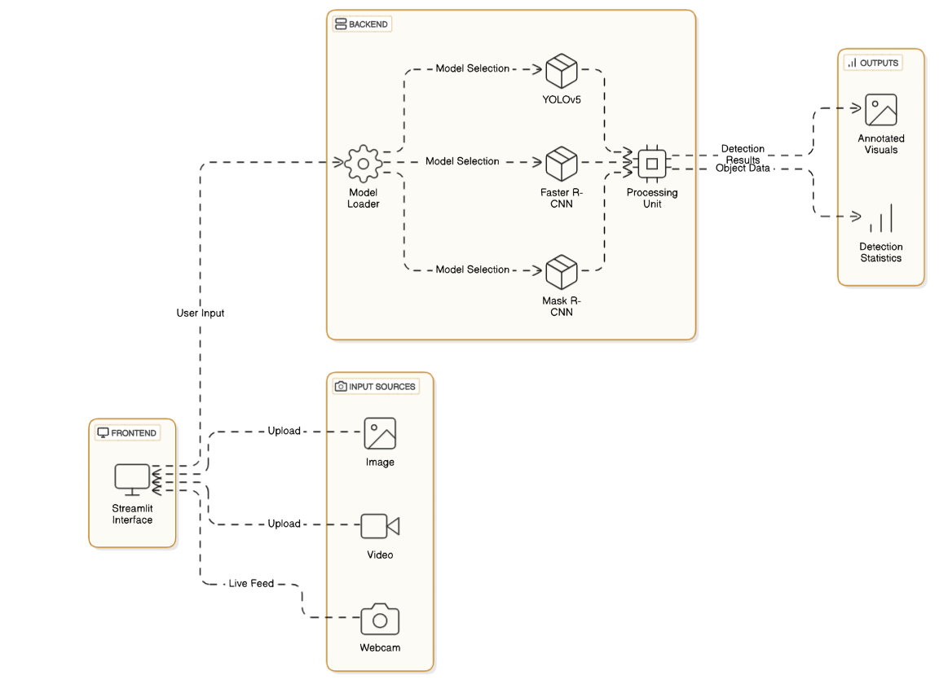
ARCHITECTURE & ​ USE CASE MODEL​

Slide 7
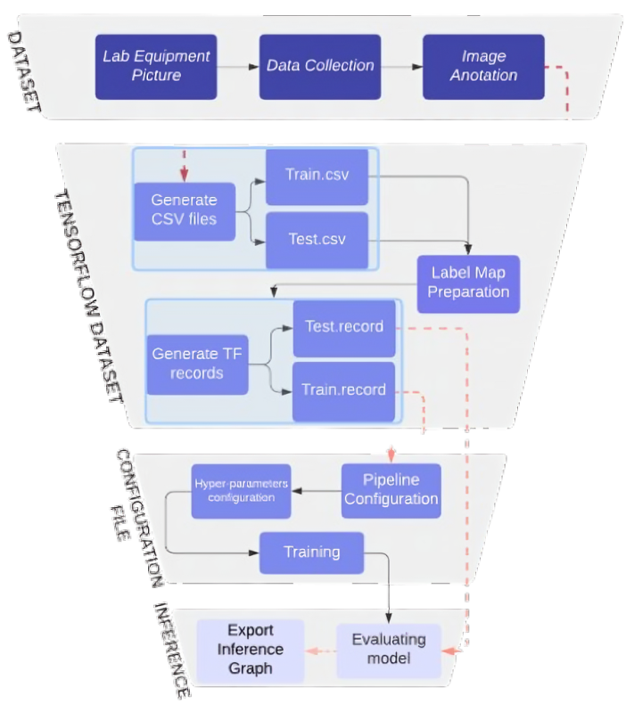
Methodology: Detection Workflow​
Workflow Steps:​
Input Selection: ​
User uploads an image/video or starts the live webcam feed. ​
Preprocessing: ​
Data is formatted using OpenCV for compatibility with detection models. ​
Model Detection: ​
Objects are identified and localized using Faster R-CNN, Mask R-CNN, or YOLOv5. ​
Postprocessing: ​
Annotated visuals with bounding boxes and confidence scores are generated. ​
Detection details (e.g., object class, confidence) are displayed in a tabular format. ​
Detection Modes:​
Image Detection: Single images processed for object localization. ​
Video Detection: Frame-by-frame analysis of uploaded videos. ​
Webcam Detection: Real-time detection from live feeds. ​
Dynamic Features:​
Adjustable confidence thresholds for precision control. ​
Real-time updates for webcam and video processing. ​

Slide 8
Model Comparison​
1. Model Features:​
2. Why YOLOv5 is Best for This Project:​
Real-Time Performance: Optimized for fast and efficient detection, ideal for live webcam and video processing.​
Versatility: Balances speed and accuracy for multiple input types (images, videos, webcam).​
Ease of Integration: Simple deployment using lightweight models.​
Application Relevance: Perfect for real-time applications where speed and responsiveness are critical.​
3. Key Highlight:​ While Faster R-CNN and Mask R-CNN excel in accuracy and specific use cases (e.g., segmentation), YOLOv5 provides a well-rounded solution for real-time detection needs.​
Feature | Faster R-CNN | Mask R-CNN | YOLOv5
Speed | Moderate | Moderate | High
Accuracy | High | High | High
Segmentation Support | No | Yes | No
Real-Time Detection | Limited | Limited | Yes
Ease of Deployment | Moderate | Moderate | Easy

Slide 9
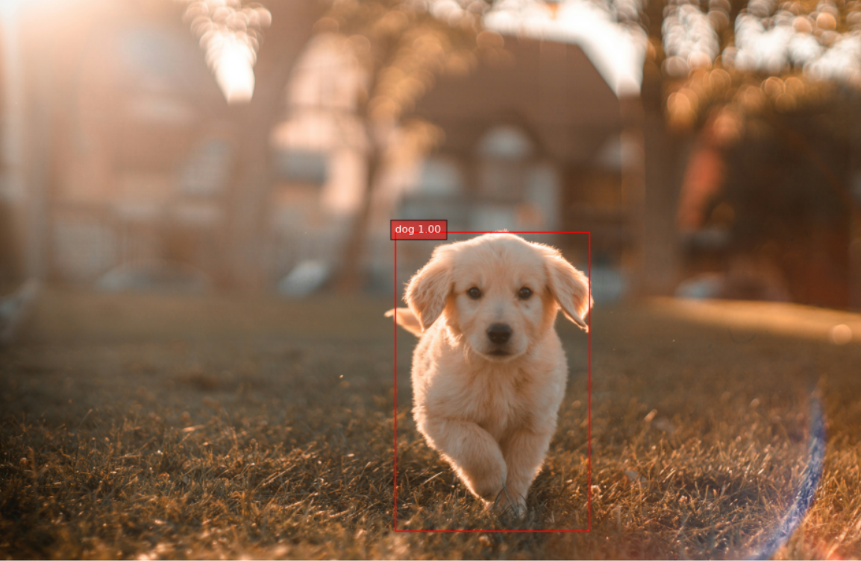
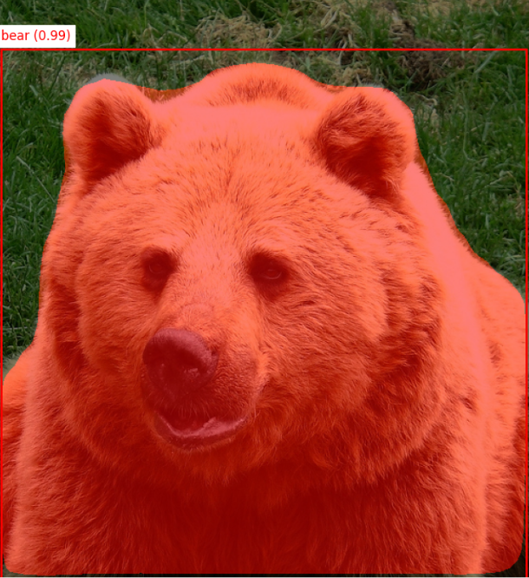
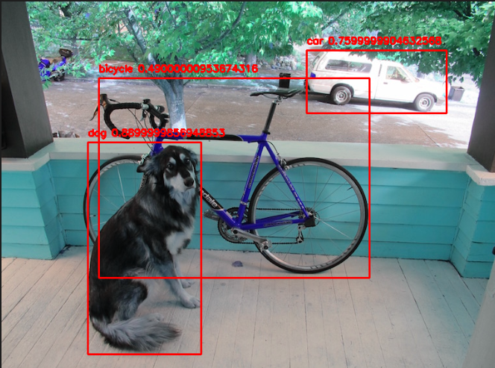
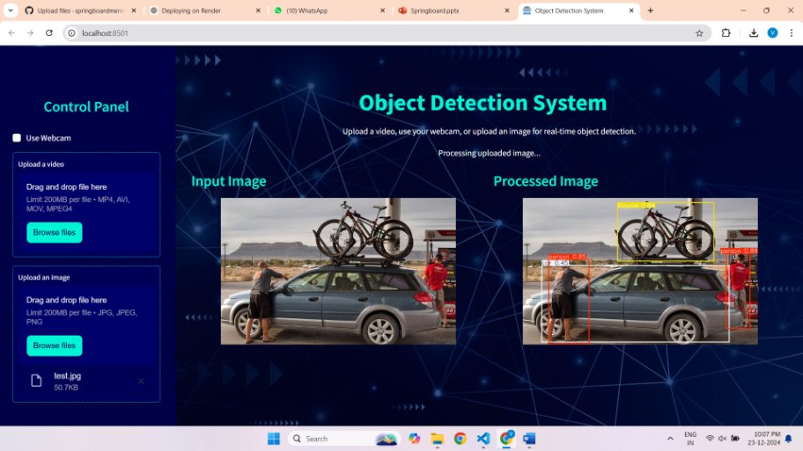
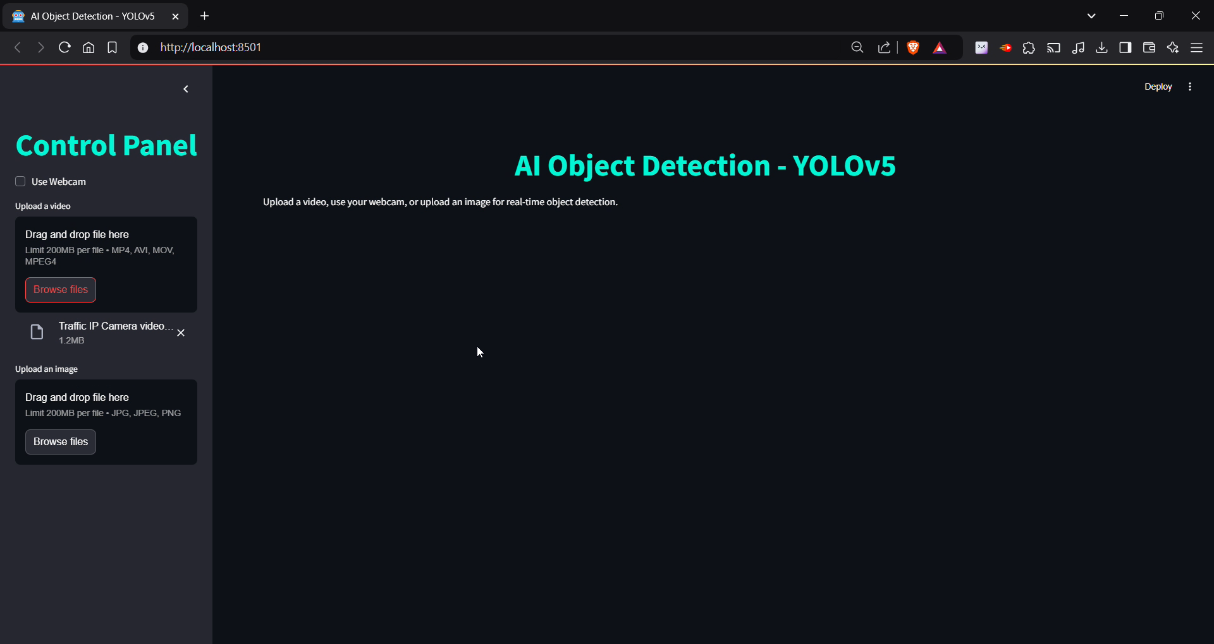
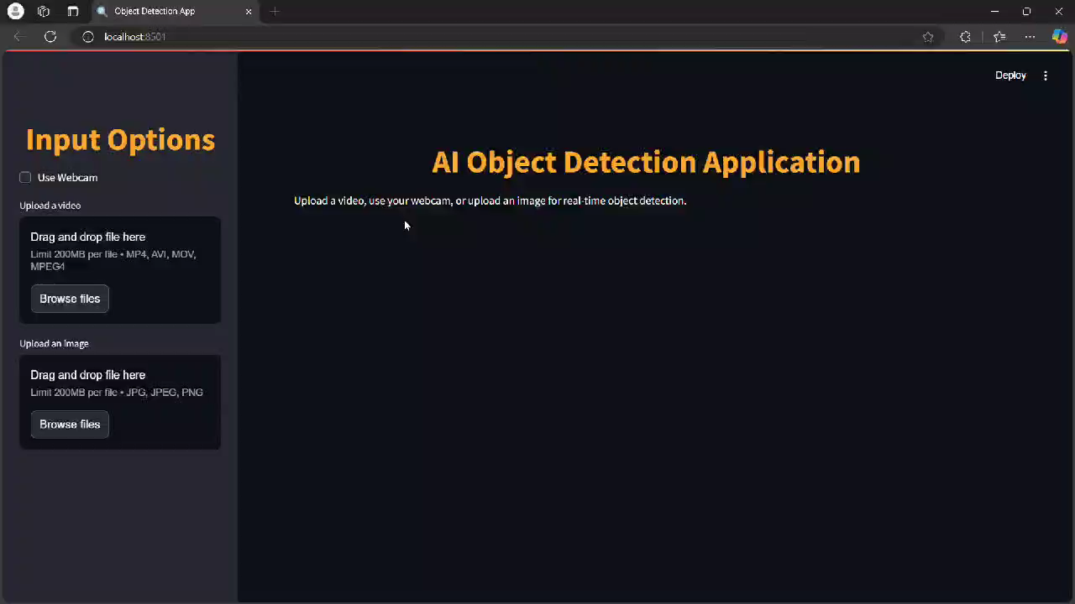
Results​
Faster RCNN Model:
Masked RCNN Model:
YOLOv5 Model:
Image Detection​
Video Detection​
Webcam Detection​

Slide 10

Challenges & Future Enhancements​
Challenges Faced:​
Model Performance: Balancing speed and accuracy across different models for real-time detection.​
Input Variability: Handling diverse input types, resolutions, and formats.​
Real-Time Processing: Optimizing detection for high-resolution videos and live webcam feeds.​
Resource Constraints: Managing computational requirements on limited hardware.​ ​
Future Enhancements:​
Multi-Model Integration: Allow simultaneous detection using multiple models for enhanced flexibility.​
Object Tracking: Add functionality to track detected objects across frames for videos and live feeds.​
Advanced UI Features: Improve user experience with customizable layouts and detection options.​
Scalability: Optimize for deployment on edge devices and multi-camera setups.​
Segmentation Support: Integrate Mask R-CNN for advanced pixel-level object detection when needed.​

Slide 11
Conclusion & Q&A​
Conclusion:​
Successfully developed an object detection system supporting image, video, and live webcam inputs.​
Integrated and compared state-of-the-art models: Faster R-CNN, Mask R-CNN, and YOLOv5.​
Highlighted YOLOv5's superiority for real-time applications due to its speed and efficiency.​
Delivered accurate, dynamic, and user-friendly detection results. ​
Key Takeaway:​
This project demonstrates the versatility of object detection models and their real-world applicability in real-time scenarios.​
Q&A:​
Open for questions and discussions.​

